Slide 1
OBJECT-ORIENTED DESIGN
Oleh Ivaniuk

Slide 2
AGENDA
Coupling and cohesion
Composition
Aggregation
Interface. Generics
Modularity

Slide 3
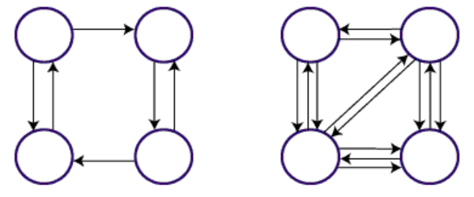
Coupling and cohesion
Coupling - the degree of interdependence between program modules (classes), a measure of how closely related two subroutines or modules; strength of connections between modules.
Low Coupling is a measure of how tightly one element is related to another, or how much data / information it has about other elements. It is a sign of a well-structured and well-designed system.
High Coupling - Strong connectivity is considered a serious drawback, as it complicates the understanding of the logic of the modules, their modification, autonomous testing, as well as individual reuse.
Low Coupling
Some dependencies
High Coupling
Many dependencies

Slide 4
Coupling and cohesion
Cohesion - a measure of the strength of the relationship of elements within the module; the method and degree to which the tasks performed by some software module are related to each other. In another sense, it is a measure of the strength of the relationship between the class method and the data itself.
A class created with high cohesion is focused on a single specific goal, rather than fulfilling many different specific goals. This is in line with the good design of the program
A low cohesion class performs many disparate functions or unrelated responsibilities. It is undesirable to create such classes, as this can lead to problems with understanding, support and use of such a class.

Slide 5
Coupling and cohesion
Low cohesion refers to modules that have different unrelated responsibilities.
High cohesion refers to modules that have largely similar functions.
Low cohesion
High cohesion
class Editor { editBooks() { // some logic } manageBookPrinting() { // some logic } reachOutToNewAuthors() { // some logic } }
class Editor { useEditTools() { // some logic } editFirstDraft() { // some logic } clearEditingDoubts() { // some logic } }

Slide 6
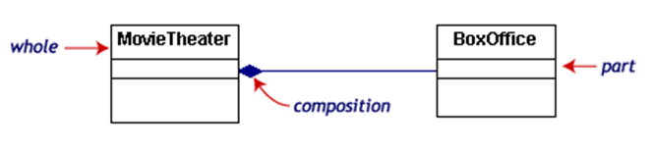
Composition
The software development process consists of breaking down large tasks into smaller ones, and components are created to solve them, and then all these components are combined into a single whole.
Composition - creating complex functionality by combining simple functions (objects). Highlight composition of functions and composition of objects. Object composition is when an object contains another object, and a nested object cannot exist without a container object. In general, composition may be more recommended than inheritance.
This example shows a composition between two classes. Composition can be interpreted as a strong connection between entities. BoxOffice class cannot exist without MovieTheater class.

Slide 7
Aggregation
Aggregation is a type of relationship where one object is part of another. Aggregation forms a weak link between objects. In the relationship between two objects, one object may play a more important role than the other.
function Book(title, author) {
this.title = title;
this.author = author;
}
const book1 = new Book ('Hippie', 'Paulo Coelho');
const book2 = new Book ('The Alchemist', 'Paulo Coelho');
let publication = {
"name": "new publication Inc",
"books": []
}
publication.books.push(book1);
publication.books.push(book2);

Slide 8
Interfaces. Generics
Interfaces define some functionality that does not have a specific implementation, which is then implemented by classes that use these interfaces. And one class can apply many interfaces.
An interface is a set of method declarations that allows unrelated objects to interact with each other, which allows an extensible class to accept implementations of other classes. What can essentially be called multiple inheritance.
JavaScript does not have natively implemented interfaces. Libraries or transilers, TypeScript, or a Proxy object can be used to implement interface emulation.
Generics allow us to create some reusable components (methods) that work with different types of data passed to them.
JavaScript is not syntactically supported by Generics. You can use TypeScript to work with them.

Slide 9
Modularity
Modularity — the principle according to which a software tool (program, library, web application) is divided into separate named entities called modules.
Modularity provides a number of important opportunities:
simplifying dependency management
code organization: separating the functionality of our application and providing encapsulation
offers code reusability
decoupling
code Extensibility
The ES6 standard has added the ability to natively create modules. A module is essentially a file with some functionality. Modules have their own scope. The import / export keywords are used to exchange functionality.
greeting.js:
index.js:
export function sayHi(person) {
console.log(`Hello, ${person}!`);
}
import {sayHi} from ‘./greeting.js’;
sayHi(‘Peter'); // Hello, Peter!

Slide 10


